Slide 1
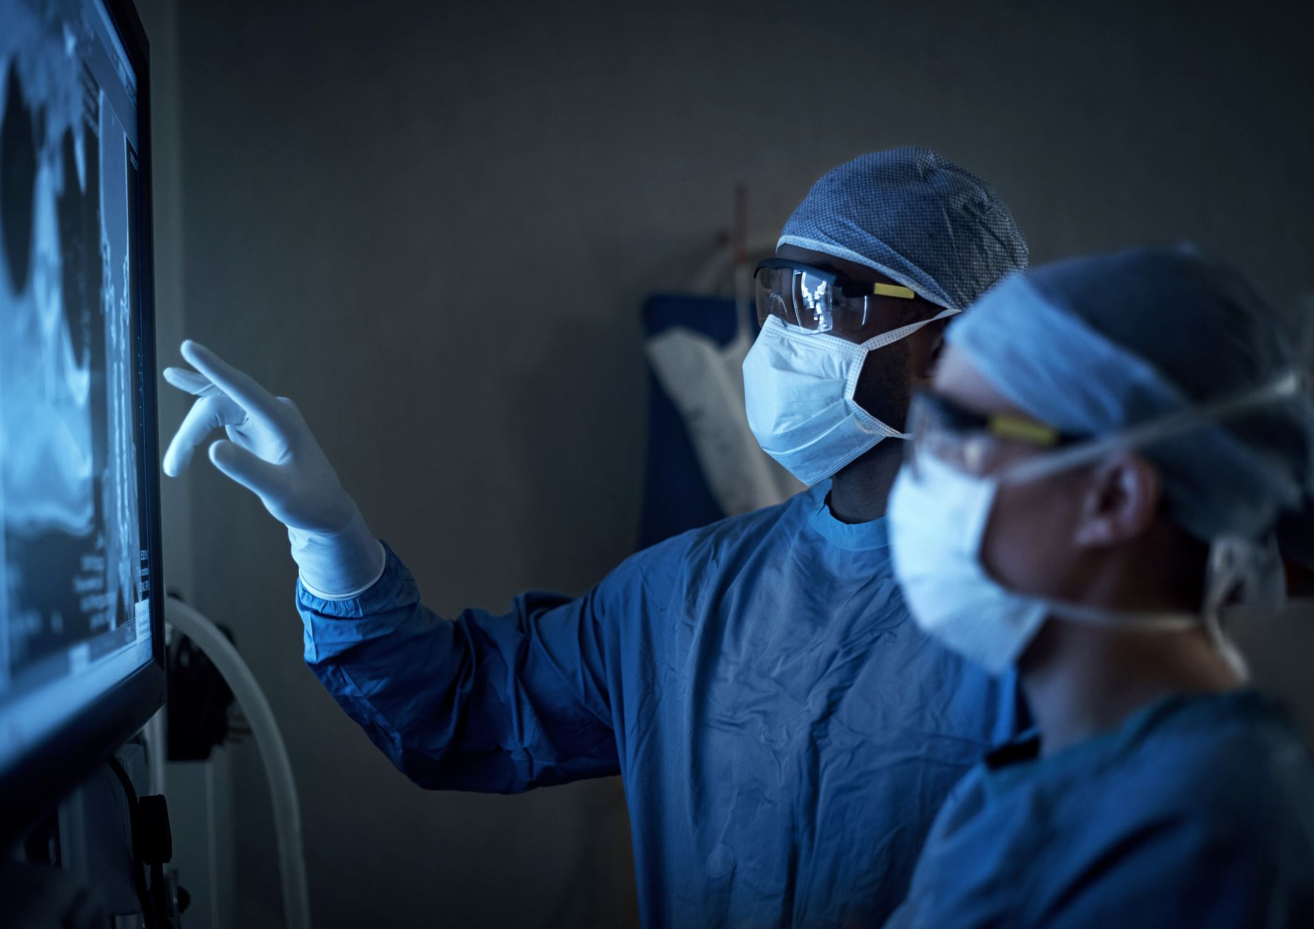
Nuclear Imaging II (PET)
RT4220 – Lecture #13
Kedree Proffitt
WSU
10/30/2025

Slide 2
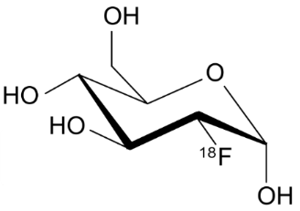
Basics of PET Imaging
Positron Emission Tomography → Positron → 2x 511 keV photons oppositely opposed → near-simultaneous detection of each photon tells us where it came from → we can quantify how much tracer was deposited in a given location
Extremely short half-life of positron emitters:
C-11: 20 mins
O-15: 2 mins
F-18: 110 mins
Short half life requires on-site production; we have a generator!
Most common PET radiopharmaceutical is FluoroDeoxyGlucose (F-18 != FDG)

Slide 3
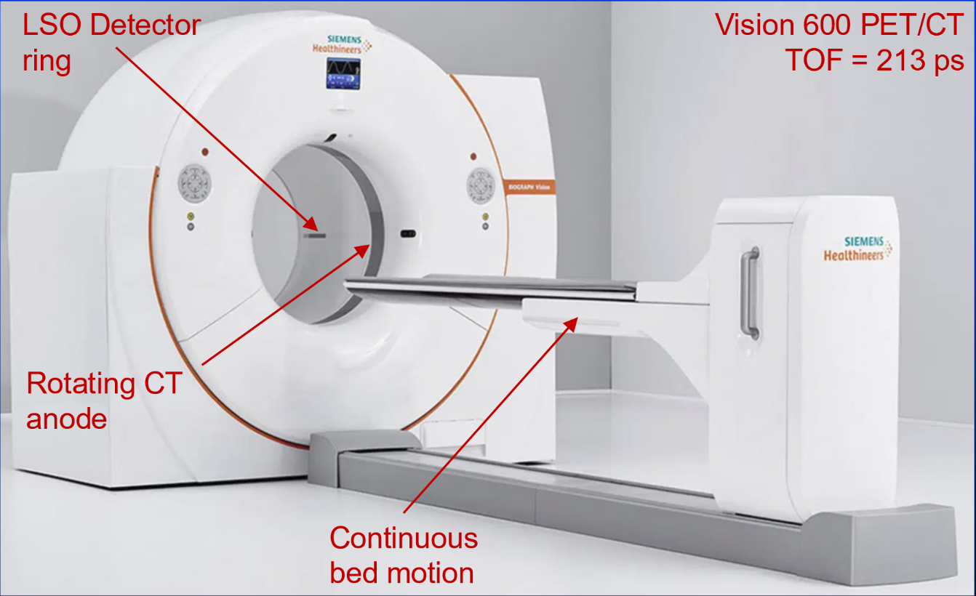

Slide 4
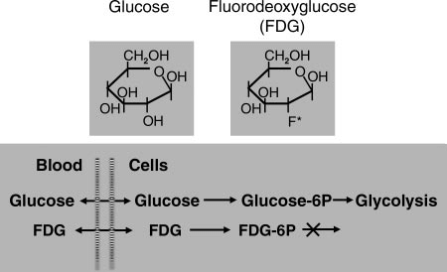
FDG Scans
Types of Scans:
Tumor imaging and staging
Detection of sub-clinical involvement
Cardiac tissue viability studies
Brain Imaging
Function:
Localizes like glucose in the body but gets stuck

Slide 5
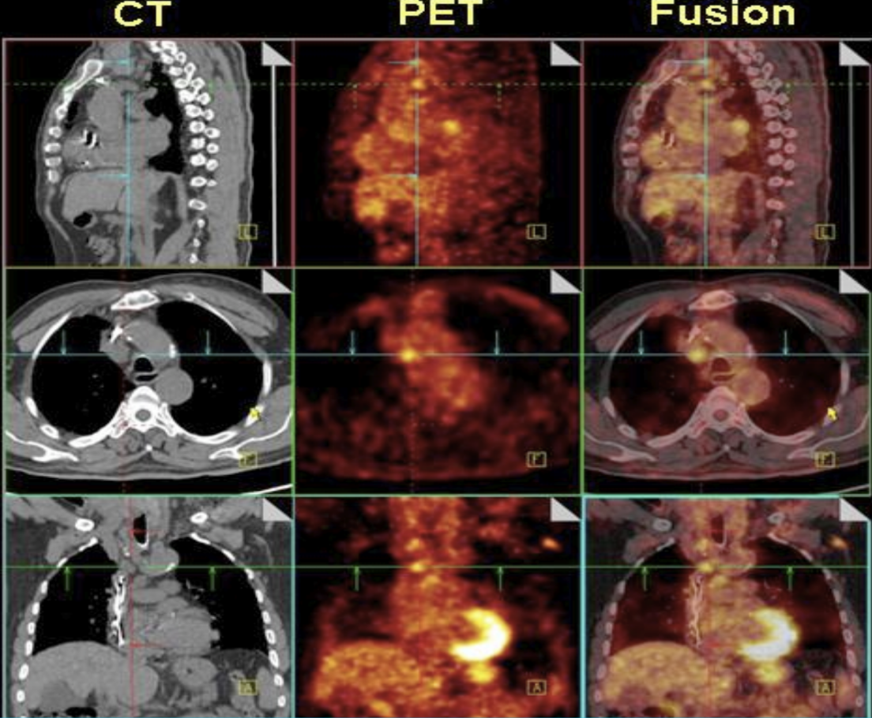

Slide 6
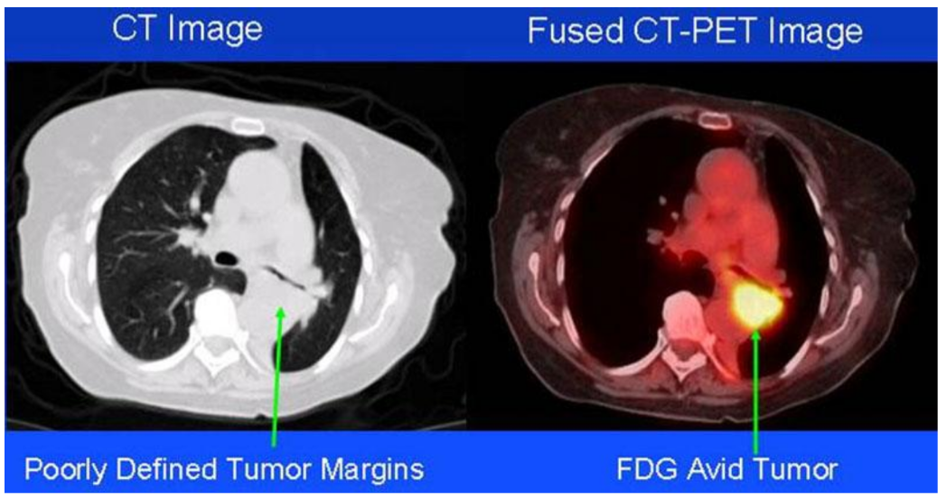

Slide 7
Common PET Usage
Primarily to detect cancer and monitor its progression/metastasis status
PET/CT has become the primary imaging tool for cancer staging
There are other great non-imaging tools!
Apparently, some are using PET to diagnose Alzheimer’s?

Slide 8
Common SPECT Usage
SPECT primarily for tracking the progression of heart disease (blocked coronary arteries)
There are also radiotracers for detecting bone, gall bladder, and intestinal disorders
Apparently, some people have used it to help diagnose Parkinson’s?

Slide 9
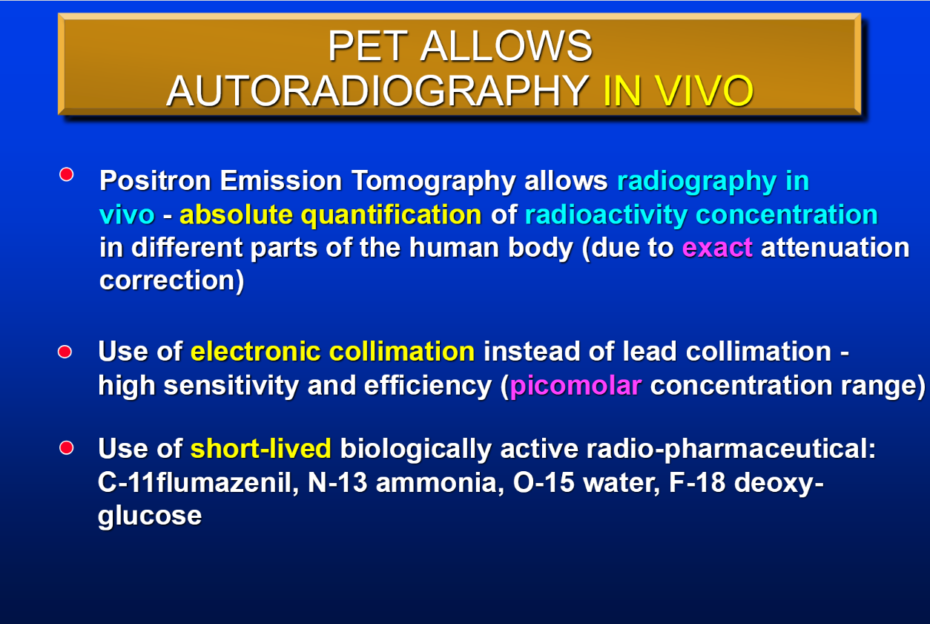

Slide 10
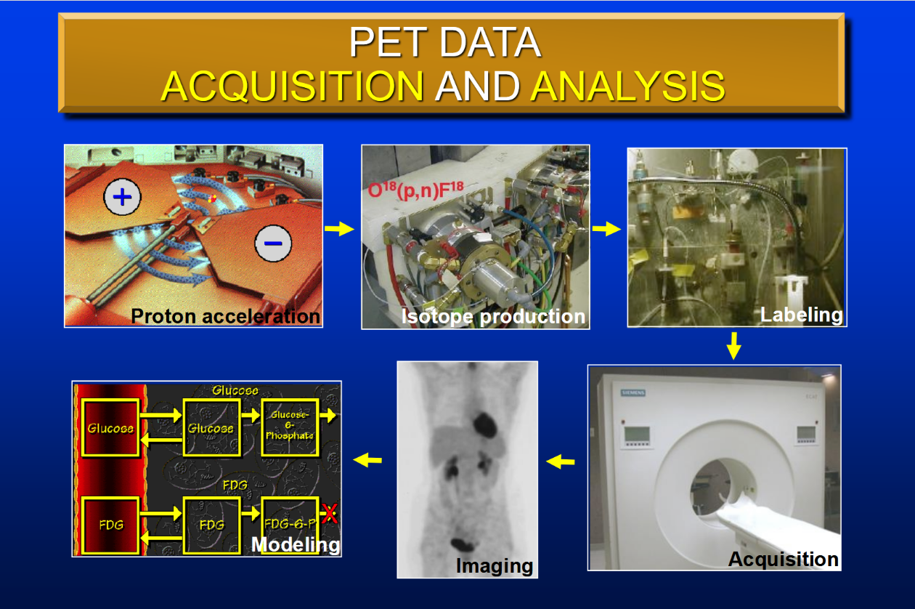

Slide 11
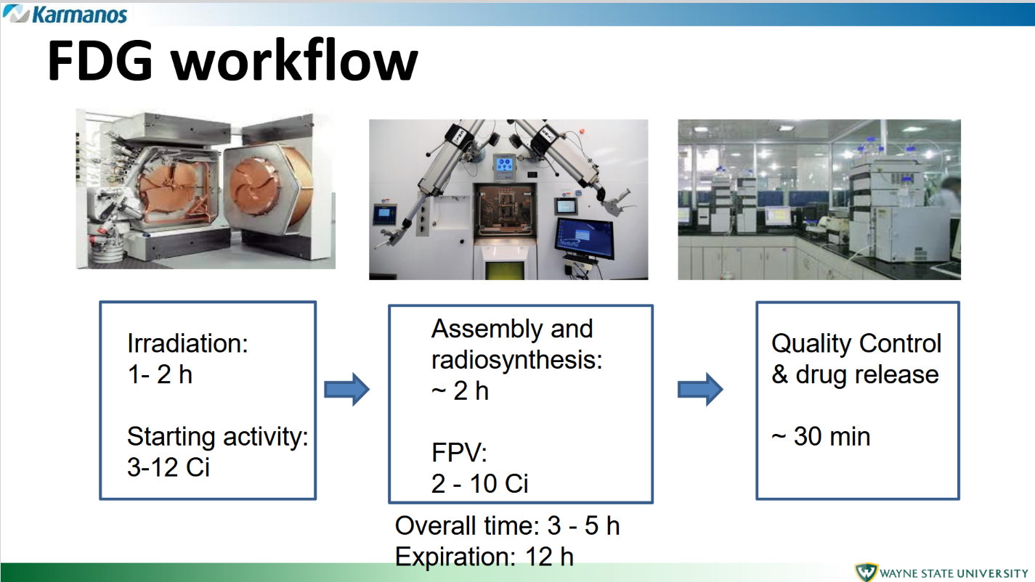

Slide 12
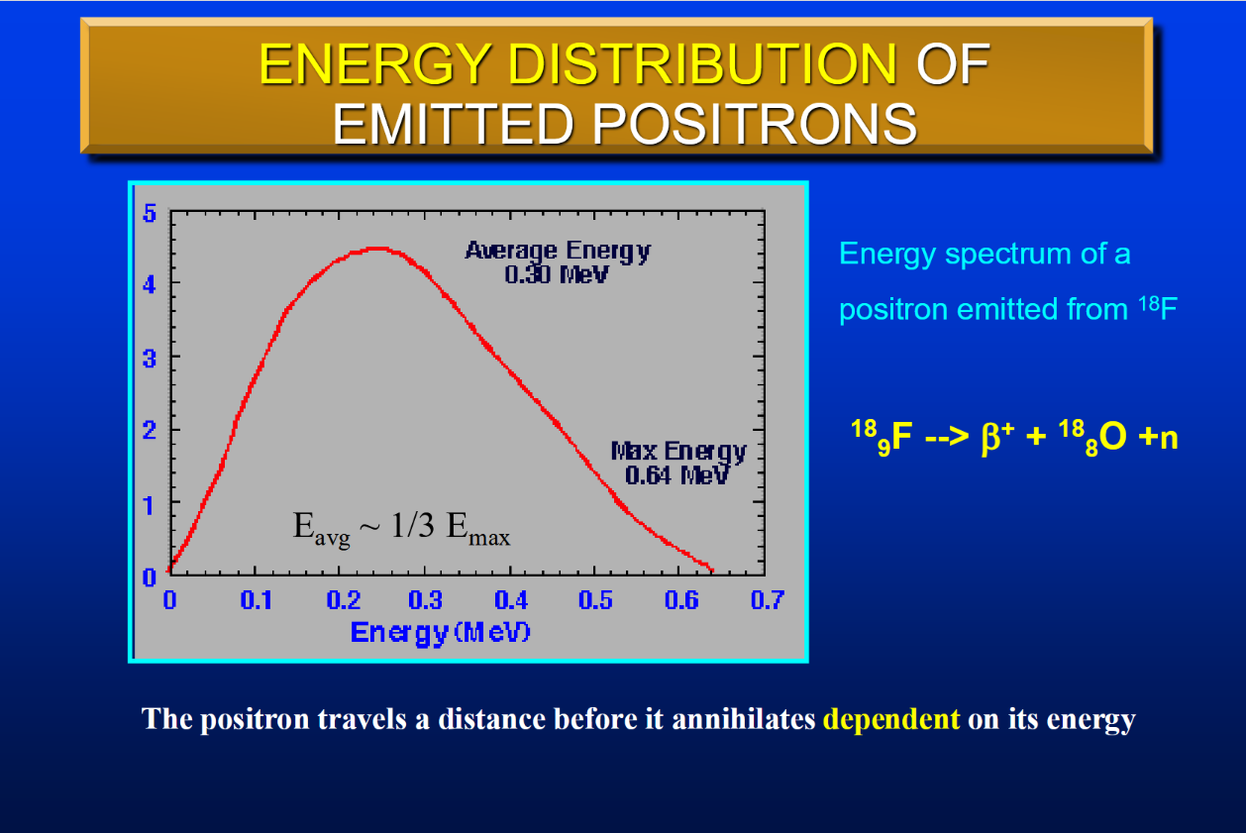

Slide 13
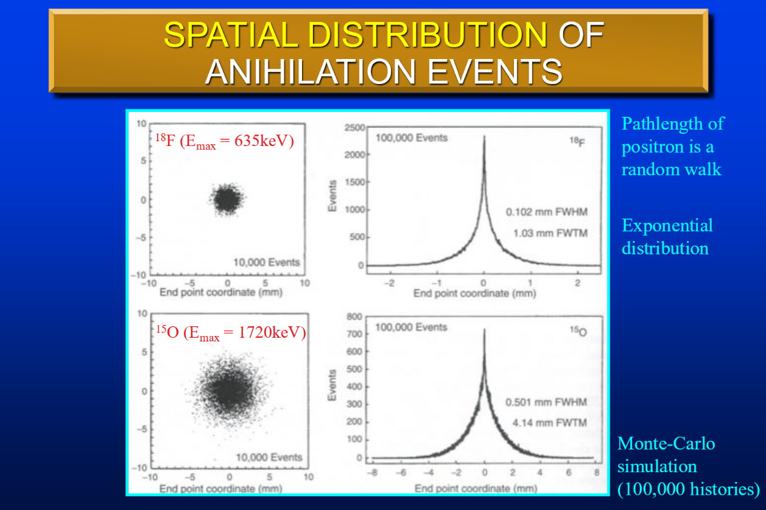

Slide 14
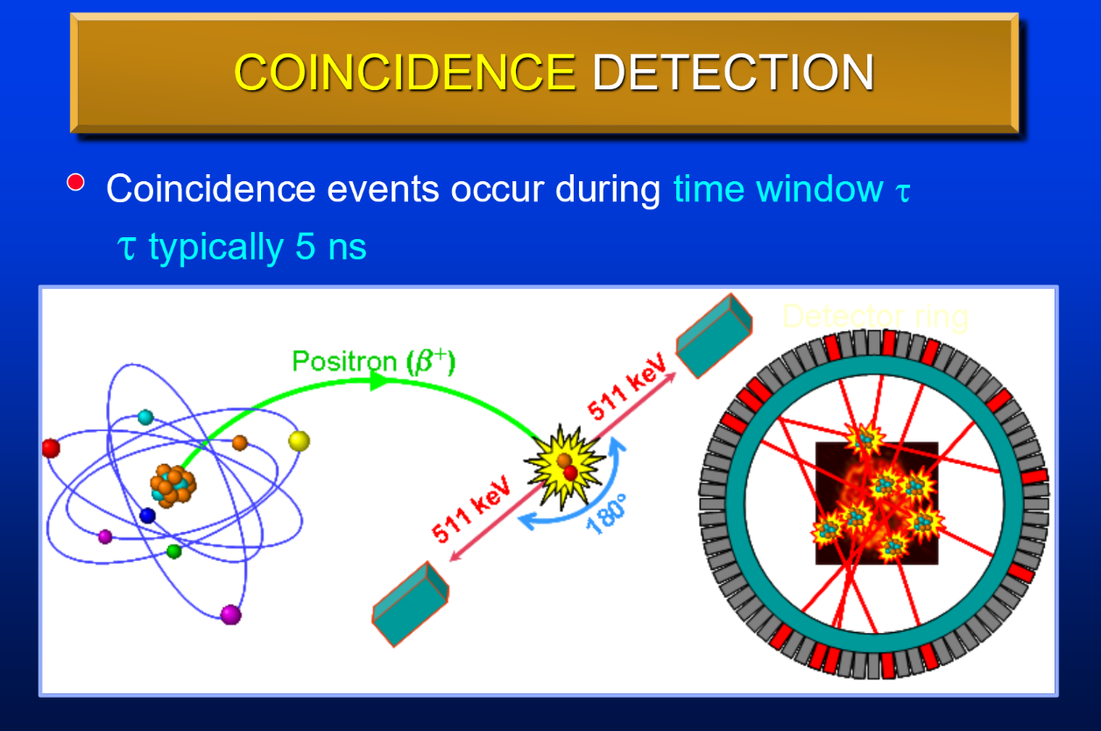

Slide 15
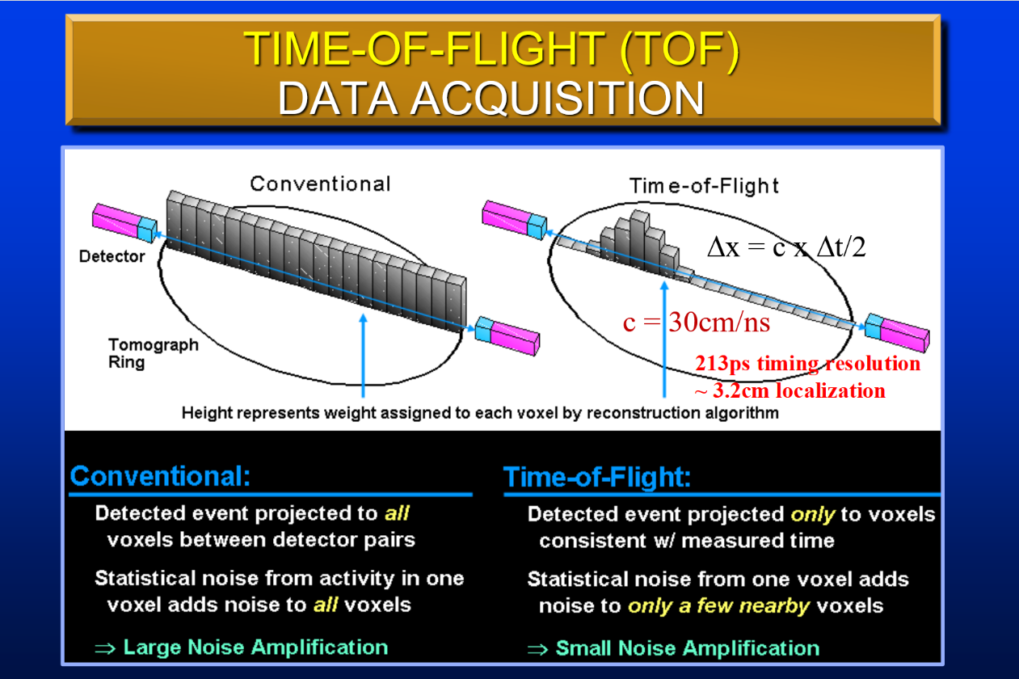

Slide 16
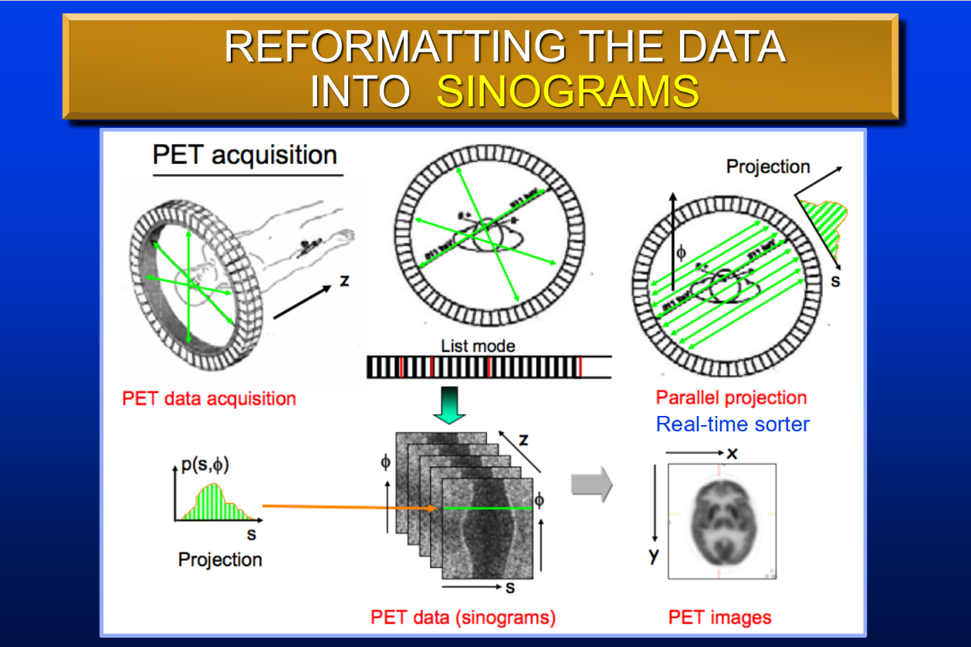

Slide 17
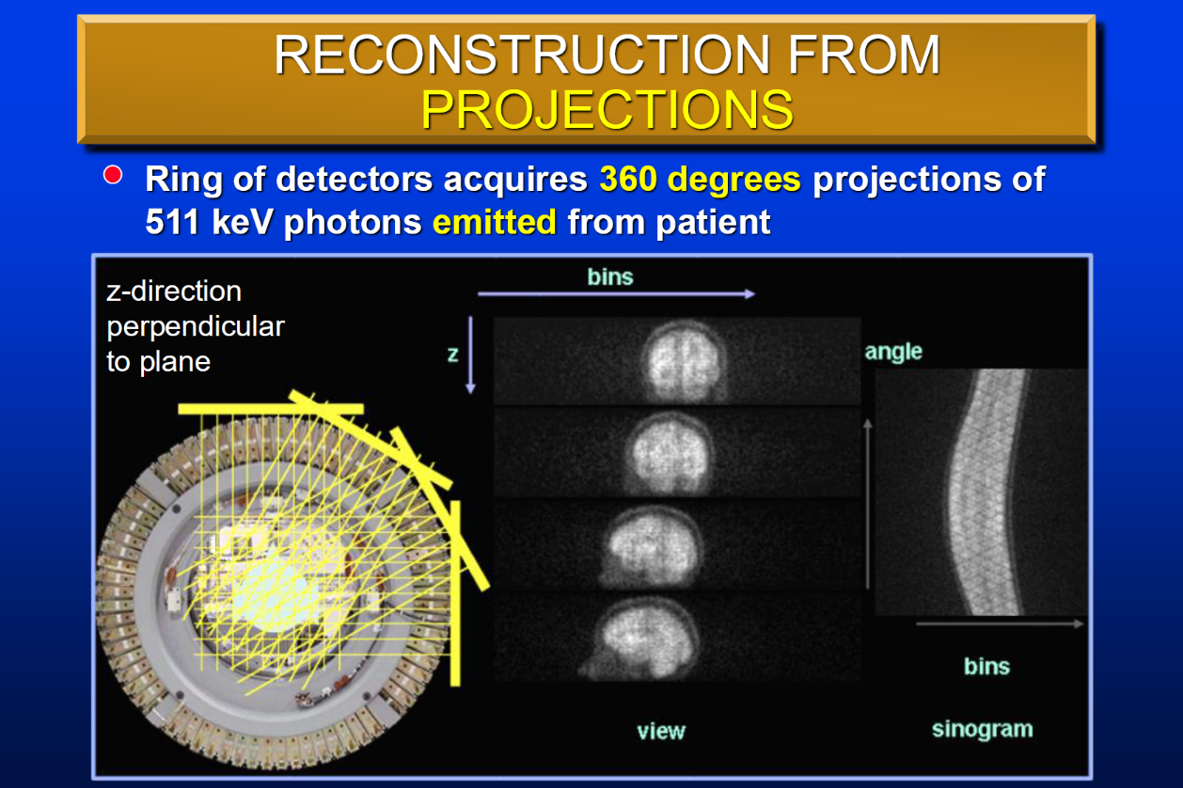

Slide 18
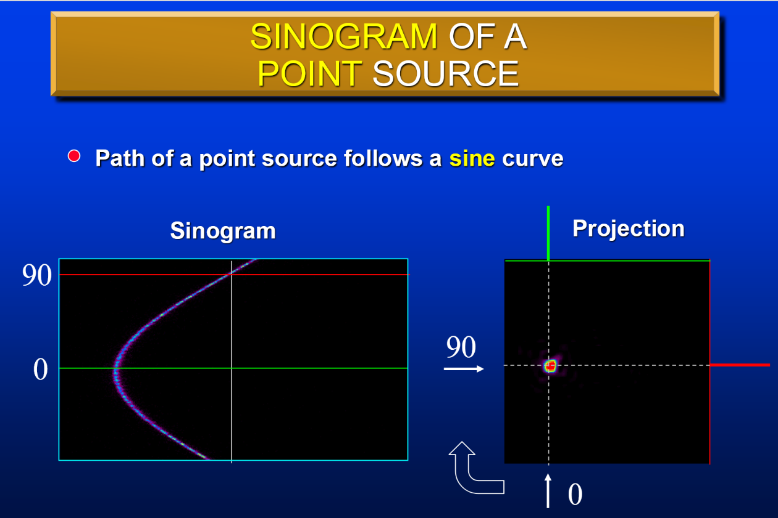

Slide 19
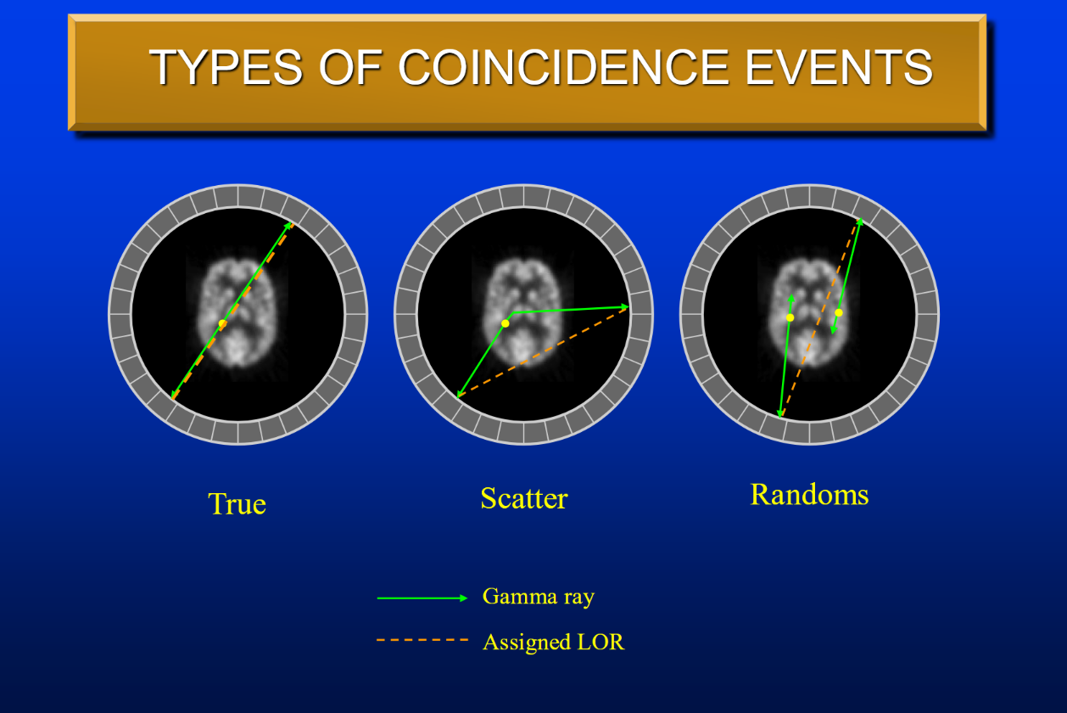

Slide 20

Other Nuclear Imaging
All the things I never saw

Slide 21
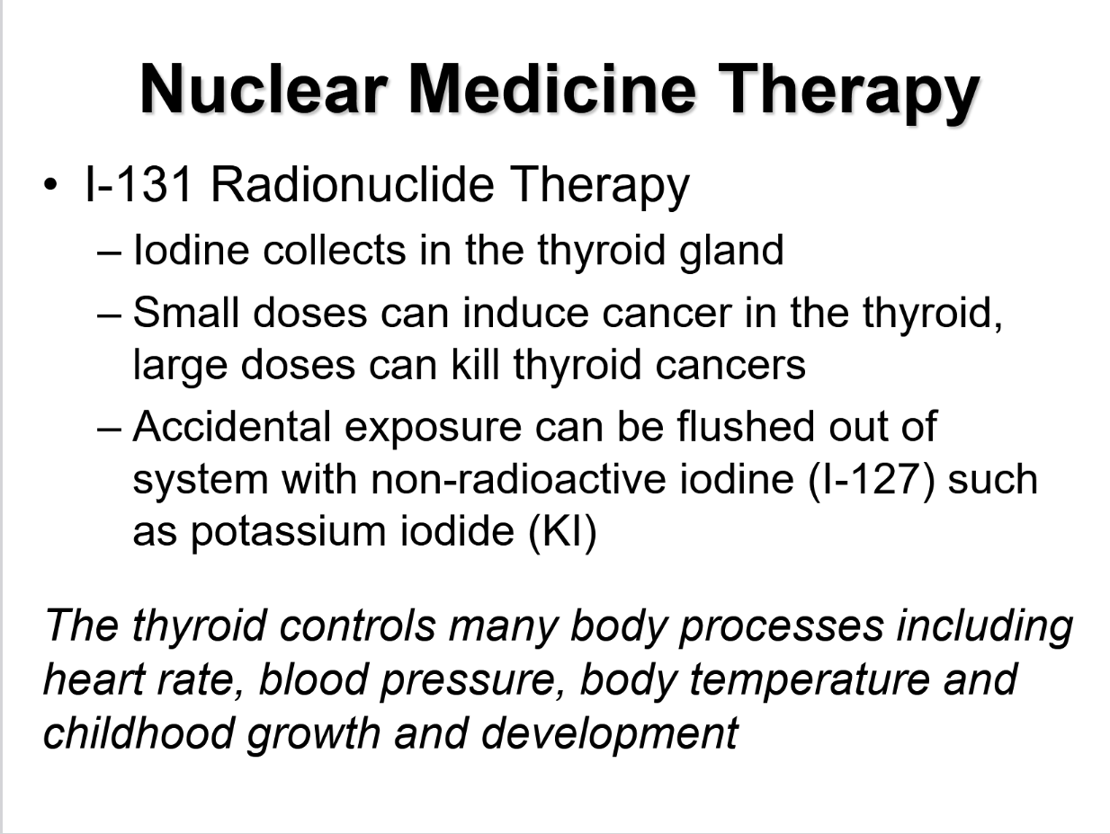

Slide 22
I-131 Therapy
I-131 (administered orally) is intended for:
Treating thyroid diseases (ie. hyperthyroidism: 4-10mCi)
Treating thyroid carcinomas (100-150mCi)
Post thyroidectomy or thyroid lobectomy (75-150mCi)
Treatment of distant metastases (150->200mCi)
Diagnostic studies (I-131: 4-10μCi or I-123: 100-200 μCi)
Therapeutic patients:
Must avoid contact with pregnant women, infants and young children for a few days post treatment
Should not sleep in the same bed with another person for a few days post treatment
Hospitals may quarantine therapeutic patients

Slide 23
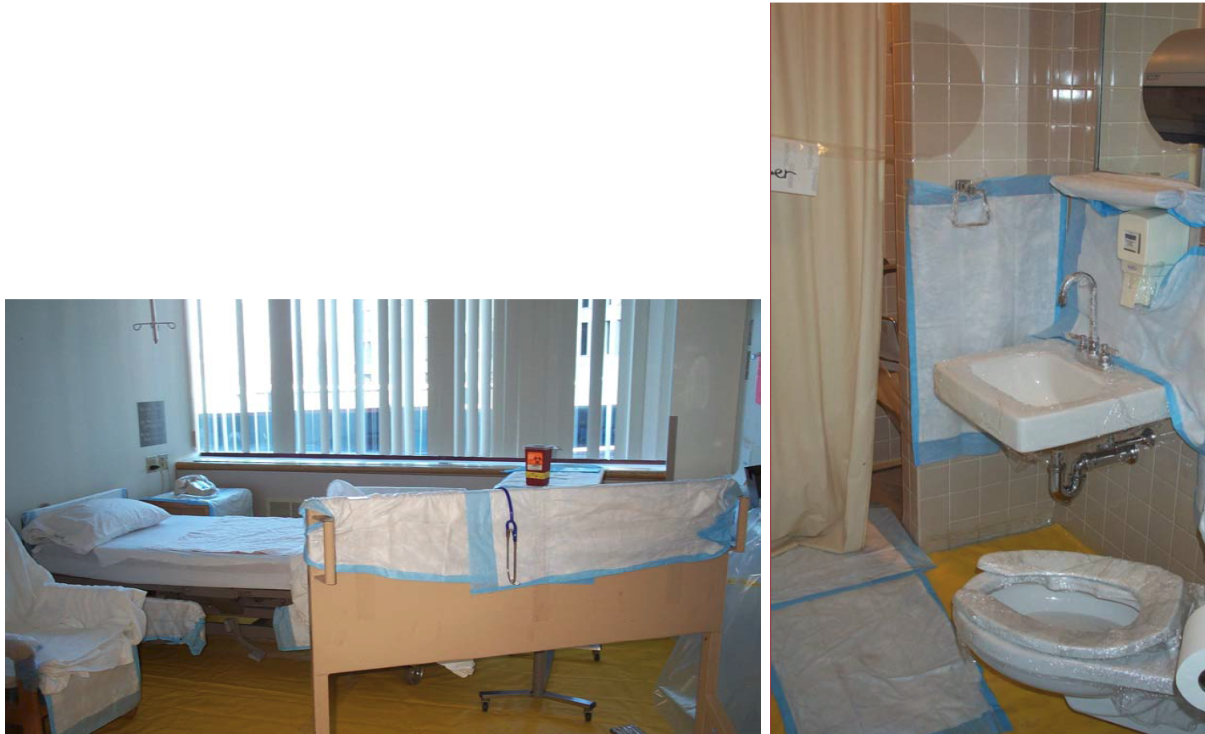
I-131 Therapy
Hospital room setup for a therapeutic I-131 patient

Slide 24
I-131 Therapy
Beta minus decay
8.01 day half life
90% of Decays have:
Max beta particle energy = 606.3keV
Average energy of 190keV (~1/3 MaxE)
Beta energy absorbed within 0.6 to 2.0mm of tissue thickness
~637 keV & 365 keV gamma emitted
Can be used for imaging or uptake measurement
I-131 is never used solely for diagnostic purposes

Slide 25
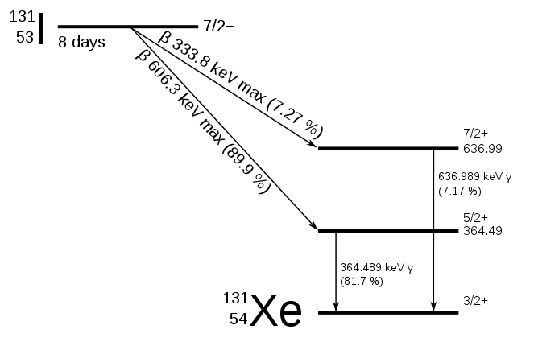
I-131 Decay Chart

Slide 26
I-123 Diagnostic Studies
I-123 has a short half-life (13.3hr)
I-131 half-life was 8.01 days
97% Beta Minus, 3% EC
Emits 159keV gammas
Allows for much lower dose to patient
Patient studies are performed 6-24hrs after ingestion
Allows time for accumulation in the thyroid
Gamma camera’s NaI detector is efficient due to the 159keV photons that emitted

Slide 27
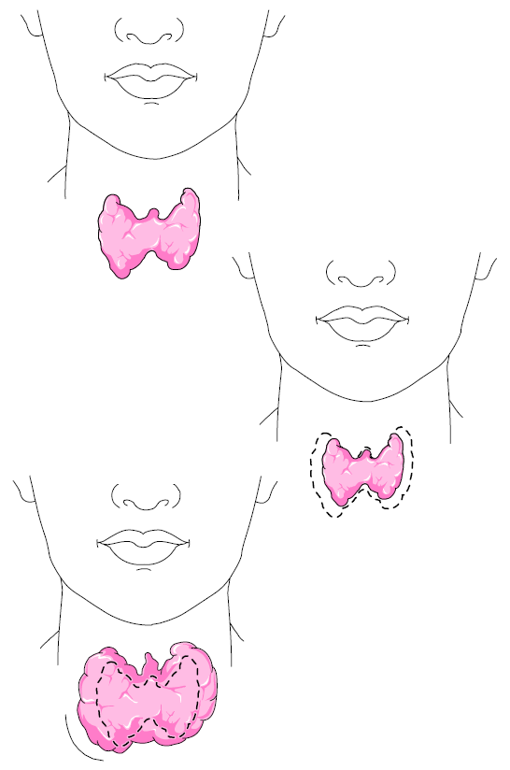
I-123 Diagnostic Studies
Thyroid uptake study:
Determine thyroid functionality by counting how much radioactivity is taken into the thyroid
Normal uptake = 15-25%
Hypo: <10%
Hyper: >30%
Performed using a gamma camera with a pinhole collimator or a scintillation detector called a “thyroid probe”

Slide 28
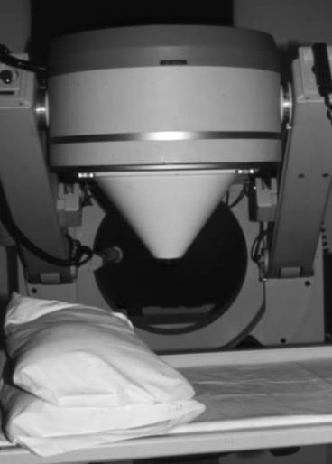
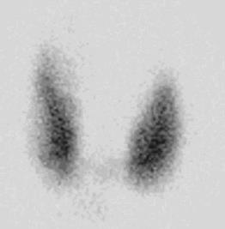
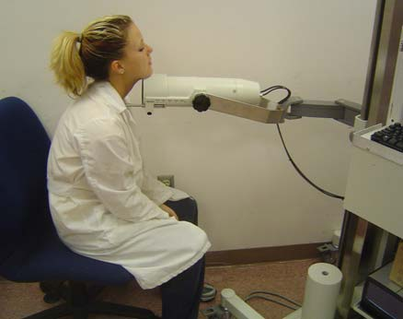
I-123 Diagnostic Studies
Imaging with Gamma Camera
Used to find abnormalities in absorption and uptake of iodine in the thyroid
Thyroid Uptake Probe
Scintillation counting system
Used to find uptake of iodine
in the thyroid
Images are not created with the
uptake probe

Slide 29
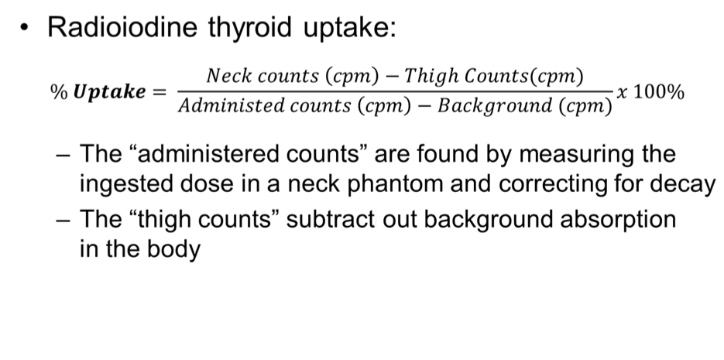
Iodine Thyroid Uptake Study

Slide 30
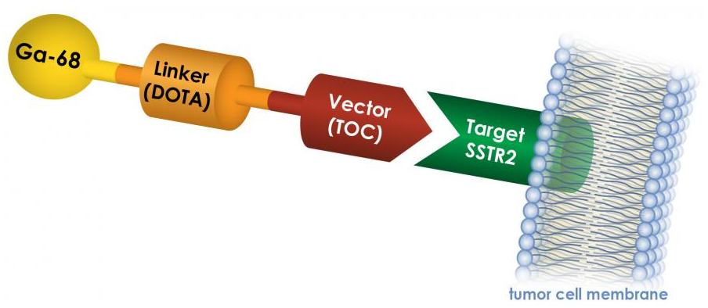
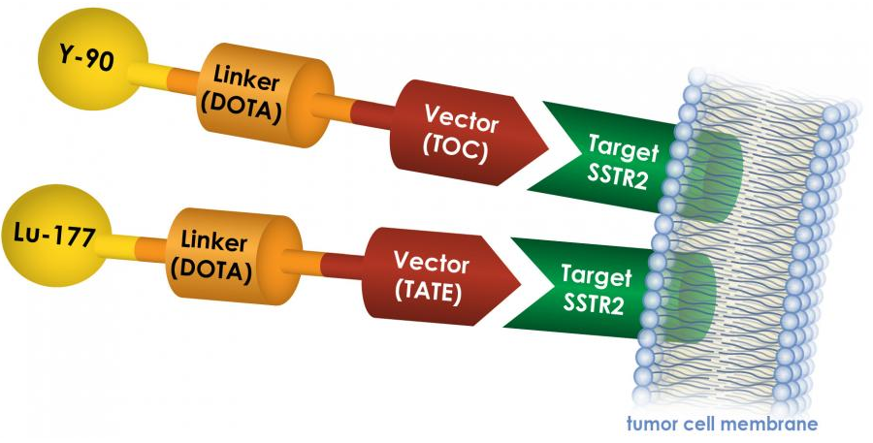
Theranostics
Thera(-peutic / Diag-)nostics
Links radionuclides to specific receptors
SSTR2 – Somatostatin Receptor
Expressed in NETs
NeuroEndocrine Tumors
Ga-68 is a positron emitter (PET)
Lu-177 DOTATATE = “Lutathera”
Notes:
Gallium-68 is used for cancer detection

Slide 31


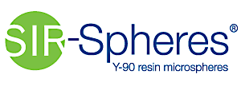
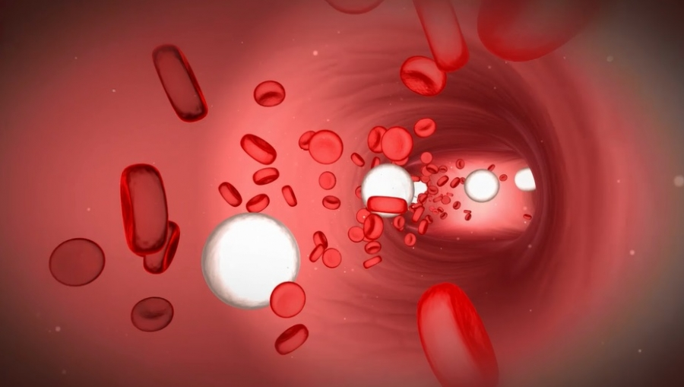
Current Theranostic Treatments of Interest
Xofigo: Ra-223 Dichloride
Bone Metastases following Prostate Cancer
Unnamed: Lu-177 PSMA
Prostate-Specific Metabolic Antigen
Lutathera
GEP (Gastroentero-pancreatic)-NETs
SIR-Spheres & TheraSphere: Y-90 MicroSpheres
HCC (Hepatocellular Carcinoma, a liver cancer)
Ac-224 PSMA
Alpha emitter

Slide 32
Trends in Theranostics
What kind of tumors?
GEP-NET’s (small percentage)
Prostate
You’ll probably have to work with these someday

Slide 33
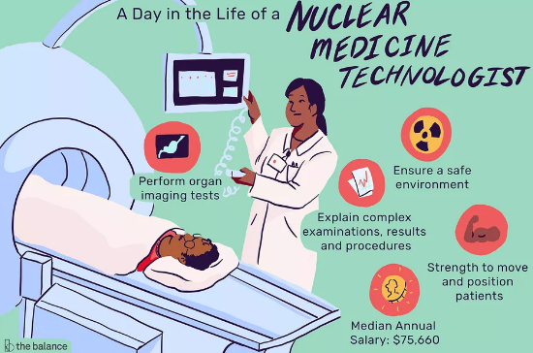
Typical workflow in Theranostics
Radiation Safety Protocol Development
Transportation of drug from hot lab to clinic to storage
Clinic safety
Policies for the room
Training of staff (physician through housekeeping)
Patient education paperwork
Package Acceptance, Verification, and Storage
Wipe test, check U/mCi, label for tx
Preparation of Drug for Delivery
In-Clinic Drug Delivery Assistance
Cleanup of Room, Radioactive Waste
Storage and Disposal of Radioactive Waste
All Text: What Physicists Do at KCI
Image from thebalancecareers.com

Slide 34

Dosimetry in Theranostics
Xofigo: 1.49 uCi/kg of patient weight sent, delivered in syringe
Lu-177 PSMA: Measure out 200mCi in a 10cc syringe.
Lutathera: Standard dose of 200mCi sent in vial, delivered to all patients via gravity method
Or, if you’re a maverick, via 60cc syringe and a chemotherapy pump

